Slide 1
Learning Journey
Soft Skills –Foundation Part 1
Implementation
in upcoming weeks
Implementation in upcoming weeks
Facilitator led assessment
Implementation
in upcoming weeks
Facilitator led session
Soft Skills –Foundation Part 6
Assessment
Facilitator led session
Soft Skills –Foundation Part 4 & 5
Submission of pre assessment video
Soft Skills –Foundation Part 2 & 3
Facilitator led session
Implementation
in upcoming weeks
You will receive for Part 6 the preparatory email from supriti.phani@capgemini.com
Learners can take the photograph of this slide using their mobile phones
Notes:
Being first day please ask learners to keep video On in the beginning , Facilitator to also be visible intermittently during the session for effectiveness . These are Freshers so this creates effectiveness . All sessions both soft skills + technical have this requirement

Slide 2
Soft Skills –Foundation Part 6 is an Assessment
Your entire team should receive an email from L & D team with guidelines for this
This email must be received by all atleast 7 days before the date of Soft Skills part 6
The method is a LIVE virtual presentation by you on a technical concept you have learnt in your Learning Journey & tool to be used is a PPT
Time of assessment – 9 am – 6 pm , could exceed to 6:30 pm
Attendance is mandatory during the day of assessment
If for some reasons , you do not receive an email – please take responsibility to inform Supriti Phani @ supriti.phani@capgemini.com
The subject line should be accurate so your email is actioned upon

Slide 3
Soft Skills –Foundation Part 4 is an Assessment
The method is a LIVE virtual presentation by you on a technical concept you have learnt in your Learning Journey & tool to be used is a PPT
Please do NOT email your final PPT ; simply keep it ready .
To have a back up, keep the PPT in a shared folder or send it to your own Capgemini email address
Attendance is mandatory during the day of assessment
Link accessible to all for an example :
https://drive.google.com/file/d/1Uqram5LEbFfg4Xq0XF676vpwIgRRkddt/view?usp=sharing
Notes:
https://drive.google.com/file/d/1Uqram5LEbFfg4Xq0XF676vpwIgRRkddt/view?usp=sharing

Slide 4
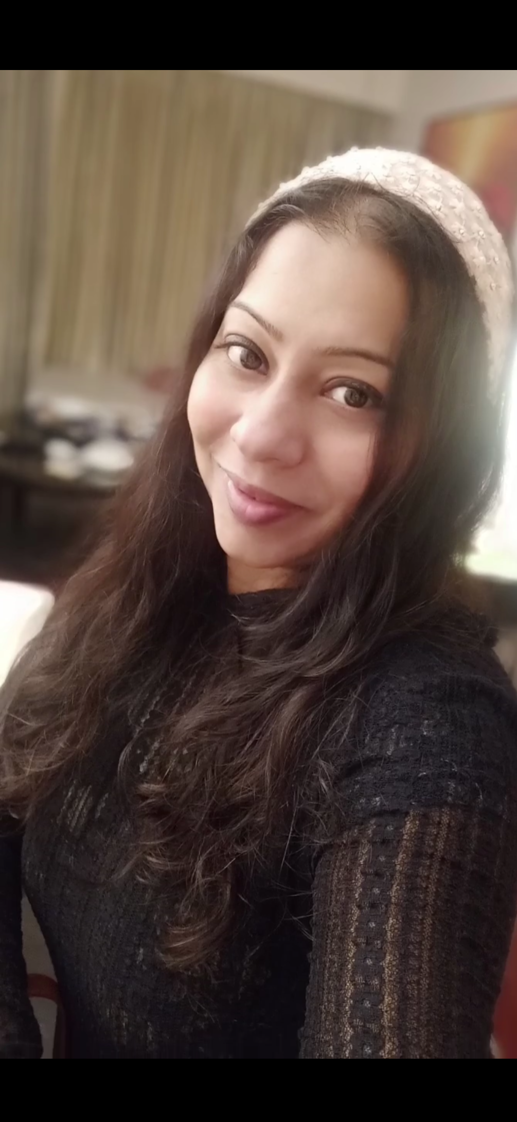
Contact details :
You will have a Batch Mentor , he / she is Your first point of contact
For soft skills training program – Supriti
supriti.phani@capgemini.com
9930363356
4

